Slide 1
RLS-Enabled Regional Sales & Profit Analytics
Final Client-Style Power BI Project Presentation
• Sales Overview
• Customer Insights & Customer Profile
• Product, Discount & Delivery Impact
• Region & Manager View
• Bookmarks, Drill-through, Custom Tooltips & Static RLS
Prepared by: Dibyalochan Dandapat
Tool: Microsoft Power BI
1

Slide 2
Project Objective
Business-focused analysis implemented in the updated Power BI report
Sales & Profit
Customers
Products & Discounts
Evaluate overall sales, profit and order
performance.
Identify high-value, low-value and profitable
customers.
Understand product profitability and discount
impact.
Delivery
Regions & Managers
Security
Analyze delivery-time trends and temporary
spikes.
Compare regional and manager-level
performance.
Restrict regional access using Static RLS.
The report is designed to support management decisions using interactive filtering, drill-down, drill-through,
custom tooltips, bookmarks and regional security.
2

Slide 3
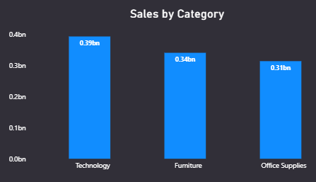
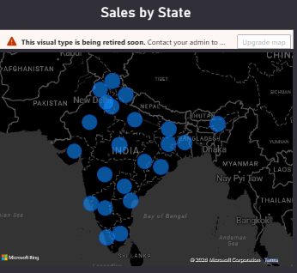
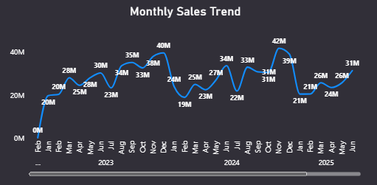
Sales Overview
Page 1 — findings recorded in the updated PBIX
Category leader
Top revenue states
Technology is the highest-performing category by both sales and profit.
Assam, Madhya Pradesh and Kerala are the top revenue-generating states.
Monthly pattern
Annual trend
Sales generally strengthen toward the later months of the year, with
November–December showing strong performance.
Annual sales declined slightly from 2023 to 2025, indicating the need to
investigate growth opportunities.
Dashboard coverage: Total Sales • Total Profit • Profit % • Total Orders • Category/Sub-category • State • Monthly Trend • Top 10 & Bottom 10 Products
3

Slide 4
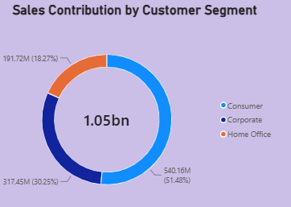
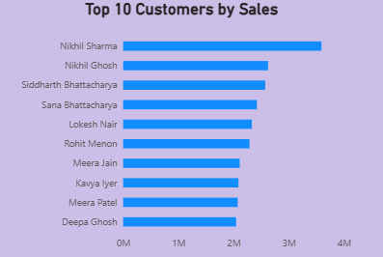
Customer Insights
Page 2 — findings recorded in the updated PBIX
• Consumer customers contribute approximately 51% of total sales and are the largest customer segment.
• Nikhil Sharma is the highest-sales customer, but his negative profit shows that high revenue does not always mean high customer value.
• Corporate customers contribute approximately 30% of sales and represent the second-largest segment.
• Customer profitability should be considered alongside sales when identifying high-value customers.
Top-value focus
Segment focus
Profitability risk
Use both sales and profit to evaluate customer
value.
Consumer is the largest sales-contributing
segment.
High revenue can still be associated with
negative profit.
4

Slide 5
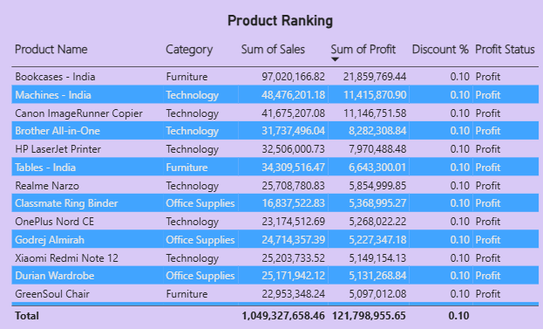
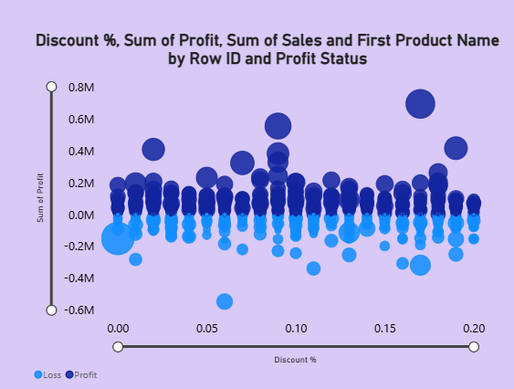
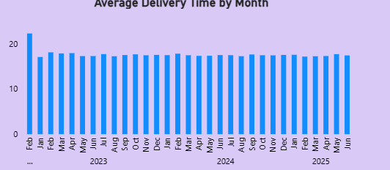
Product, Discount & Delivery Impact
Page 3 — findings recorded in the updated PBIX
Tables - India sales
Tables - India profit
Average discount
Approximately ₹62.83M
Approximately -₹5.32M
Approximately 9.8%
• Tables - India is the only major loss-making product, generating approximately ₹62.83M in sales but a negative profit of about ₹5.32M. Its average discount is around 9.8%, indicating that its pricing and discount strategy should be reviewed.
• Average delivery time is approximately 17.5 days across the dataset.
• Delivery performance generally remains within the 17–18 day range.
• Some months show temporary delivery spikes, so those periods should be investigated for operational delays.
• Delivery performance should be monitored alongside region and shipping mode to identify recurring bottlenecks.
5

Slide 6
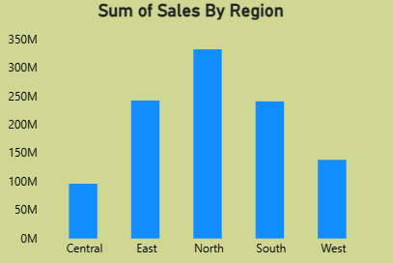
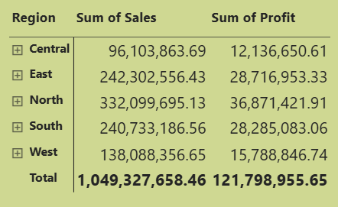
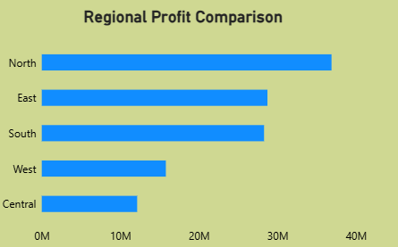
Region & Manager View
Page 4 — findings recorded in the updated PBIX
Best region
Top manager
Weakest region
North — approximately ₹332M sales and
₹36.9M profit.
Aniket Sharma — highest-performing regional
manager based on North performance.
Central — approximately ₹96M sales and
₹12.1M profit.
• Nithin Chaturvedi's Central region requires attention to improve sales and profitability.
• West also represents an opportunity for growth because its sales and profit are substantially lower than North, East and South.
• Region → State → City drill-down helps identify the locations requiring attention.
• The Region Manager matrix compares Sales and Profit for regional managers.
6

Slide 7
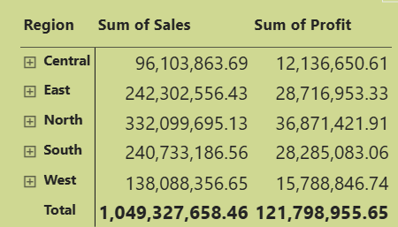
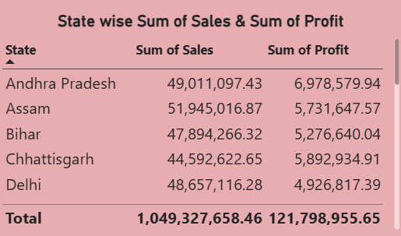
Final Insight Summary & Business Recommendations
Consolidated from the updated PBIX
Final Insight Summary
Business Recommendations
• Technology leads on both sales and profit.
• Assam, Madhya Pradesh and Kerala are the top revenue-generating states.
• Consumer customers contribute about 51% of sales.
• Nikhil Sharma has the highest sales but negative profit.
• Tables - India is a major loss-making product.
• North is the strongest region; Central is the weakest.
• Delivery averages about 17.5 days, with some temporary spikes.
• Review pricing, cost and discount strategy for Tables - India.
• Optimize discounts so sales growth does not reduce profit.
• Evaluate customer value using both sales and profitability.
• Investigate delivery spikes and recurring operational bottlenecks.
• Create targeted improvement plans for Central and other weaker territories.
• Use regional and manager KPIs to monitor both sales and profit.
7

Slide 8
Interactive Features, Security & Conclusion
Mandatory Power BI capabilities implemented in the updated report
Static RLS
Drill-through
Regional Manager access is restricted to the assigned region.
Customer Profile and Region Profile support detailed analysis.
Bookmarks
Navigation
Sales View and Profit View switch report states.
Buttons connect the report pages.
Custom Tooltips
Drill-down
Customer Details and Product Details provide contextual information.
Region → State → City supports geographic analysis.
Conclusion: The completed Power BI solution combines sales, customer, product, delivery and regional analysis with interactive
navigation and secure regional access. It helps management identify profitability issues, operational bottlenecks and territory-level opportunities.
8

